Slide 1
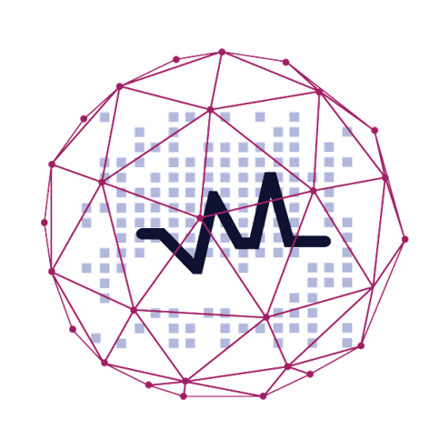
Predictive Analysis Can Help You Find Right Partner.
Learn How !

Slide 2
Agenda
At the end of the session, you will be able to :
What is Predictive Analytics?
Why Predictive Analytics?
Domains where predictive analysis is creating magic
Predictive Analysis in finding right partner
Case study on application of predictive Analysis
Companies using predictive Analysis for love match

Slide 3
What is Predictive Analytics?

Slide 4
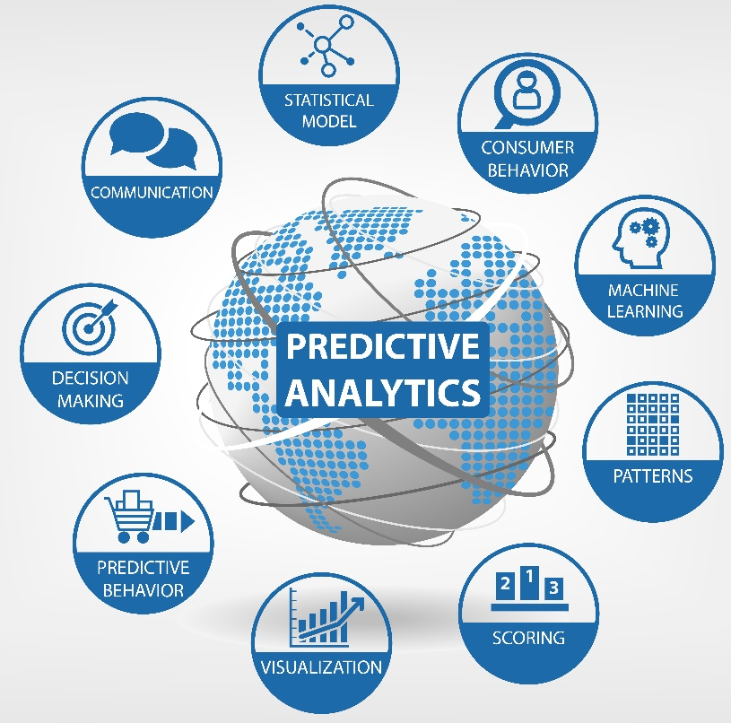
Predictive Analytics
Predictive analytics is the analysis of data by using statistical algorithms and machine-learning techniques to identify the likelihood of future outcomes based on historical data.

Slide 5
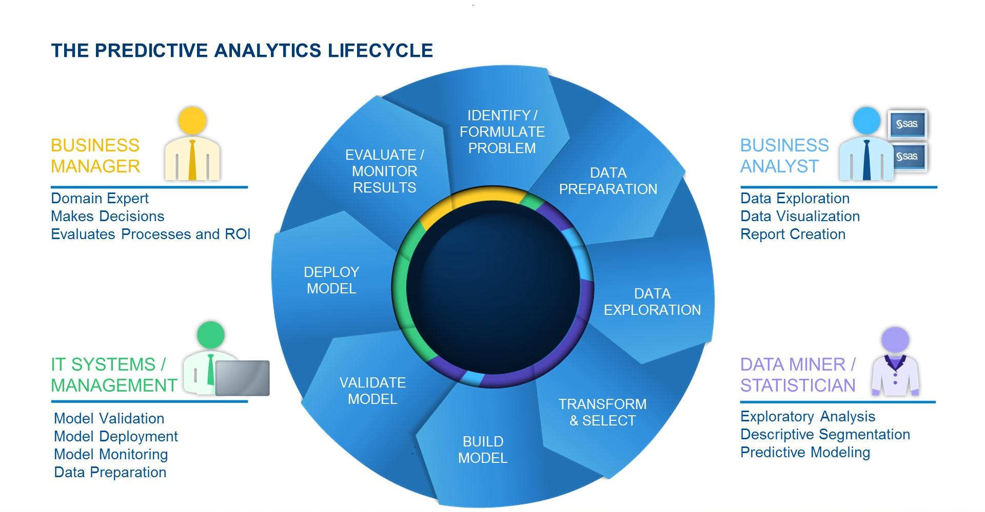
Predictive Analytics Lifecycle
Source: blogs.sas.com

Slide 6
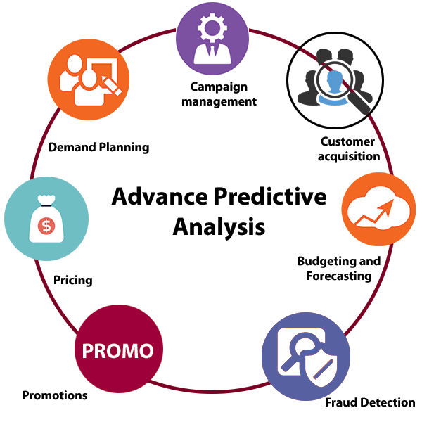
Advantages Predictive Analytics

Slide 7
Why Predictive Analytics?

Slide 8
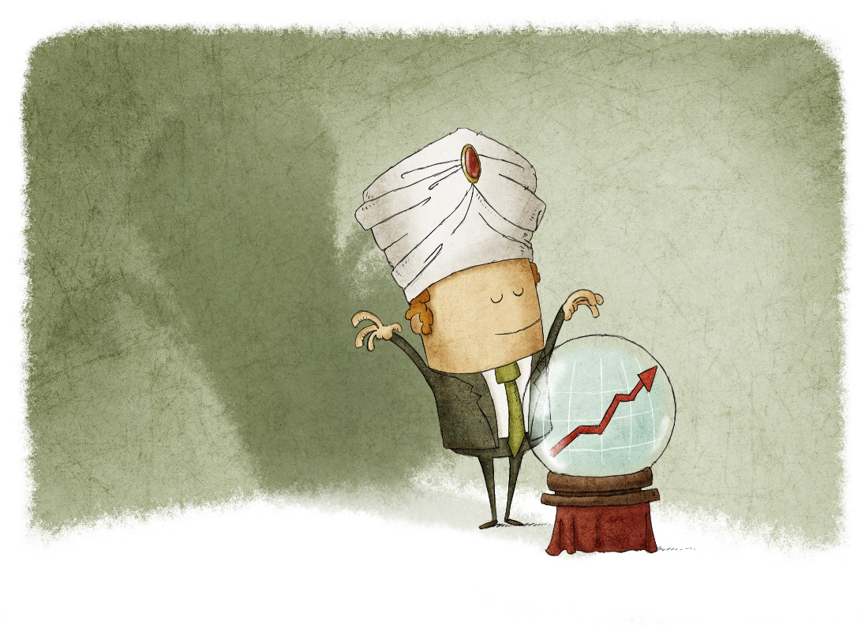
Only Analytics Is Not Enough!
Mortals Need Ability to Predict the Future!

Slide 9
Forbes Says
The top objective for between two-thirds and three-quarters of executives is to develop the ability to model and predict behaviours to the point where individual decisions can be made in real time, based on the analysis at hand.
Source: Forbes

Slide 10



Predictive Analytics Is A Game-Changer
Best Buy determined 7% of its customers were responsible for 43% of its sales. The company then segmented its customers into several archetypes and redesigned stores
Olive Garden uses data to forecast staffing needs and food preparation requirements down to individual menu items and ingredients.
The U.K.’s Royal Shakespeare Co. theatre company then developed a marketing program that increased regular attendees by more than 70% and its membership by 40%
Source: Forbes

Slide 11
Major Domains Using Predictive Analytics
E-commerce
Dating
Banking
Transport
Trading
Retail
IT Industry
Healthcare

Slide 12
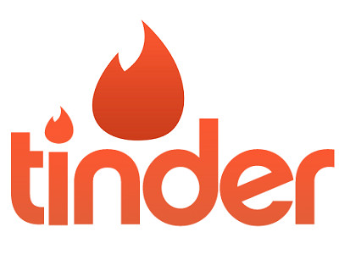






Major Dating Companies Using Predictive Analytics

Slide 13
Why Predictive Analysis in Dating domain?

Slide 14
Why Predictive Analysis In Dating Domain?
One in ten Americans have used a mobile dating app or website
Source : pewinternet.org

Slide 15
Why Predictive Analysis In Dating Domain?
One in ten Americans have used a mobile dating app or website
5% of all committed relationships in US began via something as simple as a
“like,” “swipe,” or “match.”
Source : pewinternet.org

Slide 16
Why Predictive Analysis In Dating Domain?
One in ten Americans have used a mobile dating app or website
5% of all committed relationships in US began via something as simple as a
“like,” “swipe,” or “match.”
5% of Americans who are currently married or in a long-term partnership met their partner somewhere online.
Among those who have been together for ten years or less, 11% met online
Source : pewinternet.org

Slide 17
Why Predictive Analysis In Dating Domain?
One in ten Americans have used a mobile dating app or website
5% of all committed relationships in US began via something as simple as a
“like,” “swipe,” or “match.”
5% of Americans who are currently married or in a long-term partnership met their partner somewhere online.
Among those who have been together for ten years or less, 11% met online
33% of online daters have paid to use an online dating site or app.
Source : pewinternet.org

Slide 18
Why Predictive Analysis In Dating Domain?
One in ten Americans have used a mobile dating app or website
5% of all committed relationships in US began via something as simple as a
“like,” “swipe,” or “match.”
5% of Americans who are currently married or in a long-term partnership met their partner somewhere online.
Among those who have been together for ten years or less, 11% met online
33% of online daters have paid to use an online dating site or app.
57% of Americans with an annual household income of $75,000 or more know someone who uses online dating, and 40% know someone who met a spouse or partner this way
Source : pewinternet.org

Slide 19
Why Predictive Analysis In Dating Domain?
One in ten Americans have used a mobile dating app or website
5% of all committed relationships in US began via something as simple as a
“like,” “swipe,” or “match.”
5% of Americans who are currently married or in a long-term partnership met their partner somewhere online.
Among those who have been together for ten years or less, 11% met online
33% of online daters have paid to use an online dating site or app.
57% of Americans with an annual household income of $75,000 or more know someone who uses online dating, and 40% know someone who met a spouse or partner this way
59% of all internet users agree with the statement that “online dating is a good way to meet people,”
Source : pewinternet.org

Slide 20
Why Predictive Analysis In Dating Domain?
One in ten Americans have used a mobile dating app or website
5% of all committed relationships in US began via something as simple as a
“like,” “swipe,” or “match.”
5% of Americans who are currently married or in a long-term partnership met their partner somewhere online.
Among those who have been together for ten years or less, 11% met online
33% of online daters have paid to use an online dating site or app.
57% of Americans with an annual household income of $75,000 or more know someone who uses online dating, and 40% know someone who met a spouse or partner this way
59% of all internet users agree with the statement that “online dating is a good way to meet people,”
53% of internet users agree with the statement that “online dating allows people to find a better match for themselves because they can get to know a lot more people,”
Source : pewinternet.org

Slide 21
Why Predictive Analysis In Dating Domain?
One in ten Americans have used a mobile dating app or website
5% of all committed relationships in US began via something as simple as a
“like,” “swipe,” or “match.”
5% of Americans who are currently married or in a long-term partnership met their partner somewhere online.
Among those who have been together for ten years or less, 11% met online
33% of online daters have paid to use an online dating site or app.
57% of Americans with an annual household income of $75,000 or more know someone who uses online dating, and 40% know someone who met a spouse or partner this way
59% of all internet users agree with the statement that “online dating is a good way to meet people,”
53% of internet users agree with the statement that “online dating allows people to find a better match for themselves because they can get to know a lot more people,”
11% of internet users (representing 9% of all adults) say that they have personally used an online dating site such as Match.com, eHarmony, or OK Cupid.
Source : pewinternet.org

Slide 22
Interesting Analytical Insights
Some interesting analytical insights from dating sites data :
Women get 60% more attention if photo is taken indoors
Men get 19% more attention if their photo is taken outside
Full-body photos boost both sexes success by 203%
Posing with animals or your best friends might seem cute but it actually reduces your popularity by 53% (men) and 42% (women)
Men get 8% fewer messages if they put up selfies.
Mentions of words like divorce and separated gets men 52% more messages
Women , using phrases like dinner, drinks or lunch in the first message get 73% more replies
While men who mention the same words in their opening message get 35% fewer replies
Source : KDNuggets

Slide 23
Success Of Dating Sites Worldwide
As per the survey conducted in 2014 :
In 2014 the online dating industry made $2 billion.
Match.com alone has 2.4 million paid subscribers.
Tinder, will soon start charging for a premium edition to get a bigger piece of the online market.
Source : pewinternet.org

Slide 24
Popular Dating Sites Worldwide
Tailored matches based on your profession, education history, and interests, as well who you’ve had the hots for in the past.
Provides a slew of questions to mathematically match you up with a compatible date.
Its “broadcast” service, which sends out a note to those in your vicinity
A gay men-finding app.
Following of 4 million users, and its co-ed partner
Allow you search the social network of nearby singles looking to connect.
Leverages the mobile location
Using FB to determine mutual friends, interests and location.
“Like” a profile and if they like you back, you two can see more information about each other, chat and make plans.
Good for: the dater who values privacy.
Same as match.Com but aimed at finding love.
The selling angle is the ability to find a mate and higher odds of getting married.
Focusing on Spaniards, Italians and French
Makes easier to find people nearby looking for romance.
Some 200 million people signed up worldwide,
25 million of them active users.
How Popular dating sites worldwide offer their services

Slide 25
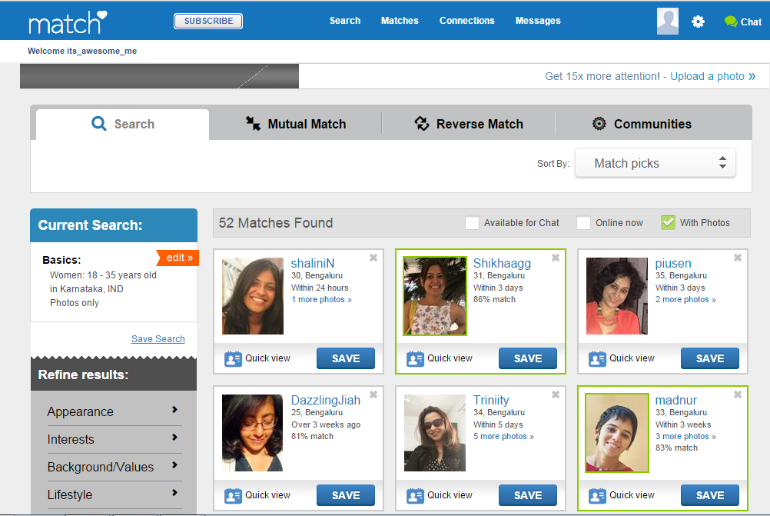
Case Study
Case Study : Match.com

Slide 26
Features
Freedom of expression :
We give singles the opportunity to express themselves through various free writing sections.
Profiles may include up to 26 photos, as well as selected preferences regarding the person they're searching for.
Privacy :
All communication between members happens through an "anonymous" email network.
The names and contact information of all our members are kept confidential until the member personally decides to share the information with a potential match.
Integrity :
Every profile and photo is screened by our customer care team for appropriateness before it's posted to the site.
Guarantee:
If you don’t find someone special within 6 months,we’ll give you an additional 6 months free

Slide 27


Have we got a girl for you??

Slide 28
Match.com
Match.com uses Chemistry.com to do personalized surveys and get detailed preference data.
Use analytics to match people based on their potential love and mutual attraction and attempting to predict mutual match
e.g. The person A is a potential match for person B…. but with high probability that person B is also interested in person A.

Slide 29
Challenges And Solution For Predictive Analysis
Validity of the data
People have a tendency to lie (or exaggerate) about age, body type, height, education, interests etc.
So excluding certain variables or taking a multi-dimensional scoring approach with different weights would be appropriate.
Skewness of data
A small subset of users will receive the majority of the messages.
To even this out they look at the number of unread in-box messages and place users further down the match list if he/she has tons of them.
The popularity metric helps them match people with similar status on the site.
User misbehavior
Misbehaving users are a continuous battle especially on a free site .
To fight this, they use computer and human defenses.
Their software and human intuition can detect if someone sets up multiple accounts, exhibits bad behavior, and can then flag their accounts for review or automatically disable
Continuous upgradation of Algorithm
Large amounts of data on its users, which Maxim says it uses to improve its products and monitor if the site or algorithm needs fixing.

Slide 30
Did you know that Facebook can look at its user’s posting patterns and moods in order to predict their future romantic relationships?

Slide 31
Case Study
Case Study : Facebook.com

Slide 32


Facebook Couple Prediction
No relation
In physical touch
Facebook knows before you do when you are going to become a couple.
It certainly knows long before you announce it on your relationship status.
Facebook can tell when the physical part of your relationship begins

Slide 33
References
http://scitechnow.org/technology/dating-today-love-lives-decided-algorithmically/#
http://support.sas.com/resources/papers/proceedings11/047-2011.pdf
http://www.business2community.com/facebook/facebooks-predictive-analytics-a-love-story-01304017
http://www.allanalytics.com/author.asp?section_id=1412&doc_id=238774
http://www.allanalytics.com/author.asp?section_id=1412&doc_id=235266
http://blog.okcupid.com/
http://www.slideshare.net/mongodb/big-dating-at-e-harmony-06232014final-1
http://www.scientificamerican.com/article/dating-services-tinker-with-the-algorithms-of-love/
http://www.kdnuggets.com/2015/06/love-sex-predictive-analytics.html
https://www.linkedin.com/pulse/love-sex-predictive-analytics-lars-hamberg

Slide 35
Survey

